Slide 1
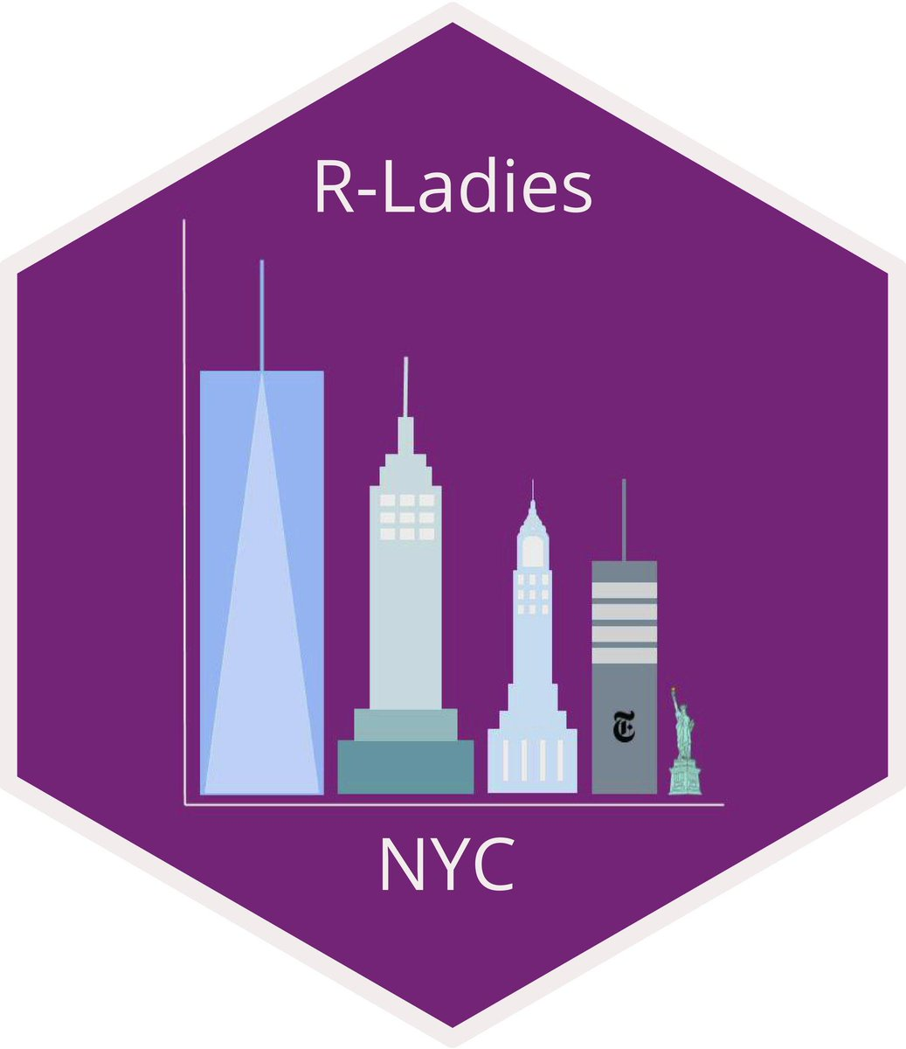
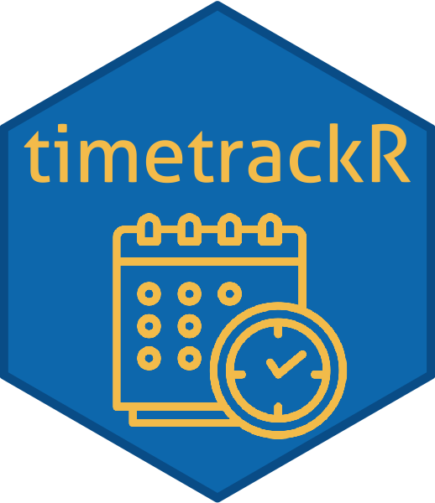


It’s Time to Shine with the timetrackR App
April 30, 2020
Jessica Lavery

Slide 2
Introductions
Who am I? Research Biostatistician in the Department of Epidemiology & Biostatistics
What do I do?
Retrospective data analysis, end goal is a manuscript in a peer-reviewed journal and/or a conference presentation
Protocol development, end goal is a clinical trial research protocol
Broken into smaller tasks: project management, data management, statistical analysis, manuscript writing
Who are my collaborators?
Faculty statisticians
Clinical researchers

Slide 3
Today’s Objectives
Why track your time?
How to track your time?
What to do once you’ve tracked your time (an introduction to timetrackR)
timetrackR demo
Useful R code learned in the process
Future work

Slide 4
Why track your time?

Slide 5
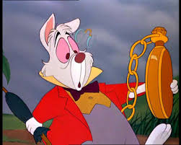

Time & the busy data analyst
Often feels like there aren’t enough hours in the day
Start working on one project, check email, bounce to another project, maybe remember to go back to first project, and oh look! It’s 5pm
Long term: you have no recollection of how you’re spending your days

Slide 6
So what’s the problem?
It’s hard to manage your time if you don’t know how you’re spending your time.
Notes:
Recall is often inaccurate: Feels like we spend a lot of time on projects we don’t love and not enough time on projects we do

Slide 7
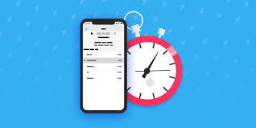
How to start tracking your time?
Notes:
"time audit” with a goal of answering the question of “Where is my time going and can it be efficiently directed?”

Slide 8
Toggl
A website or desktop app that can be used to log how you are spending your time
Can let it run in real time or back-enter tasks
Tasks are grouped by projects and clients
Can use tags to further identify groups of tasks
Has functionality for organizing a team and for tracking billable vs non-billable hours

Slide 9
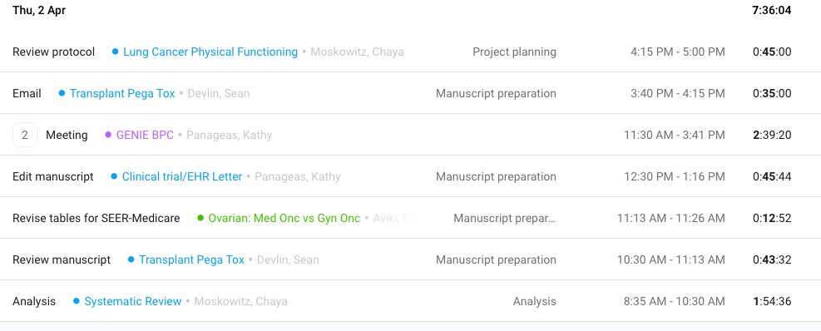

Slide 10
How I use toggl
I track the “client” as the faculty statistician I’m working with
Could also have used the clinical collaborator, but would have many more clients
Tags describe project phase (data cleaning, data analysis, manuscript preparation, etc.)
Descriptions are more variable

Slide 11
Pros & Cons of Toggl
Pros
Cons
Free version available
Can easily integrate into your workflow
Not a lot of up-front setup required
Can export your data
Free “insights” only include total hours per day, percent time by project or client
Paid insights pertain primarily to billable hours, which isn’t as relevant for my work

Slide 12

Thus, a (Shiny) star was born

Slide 13
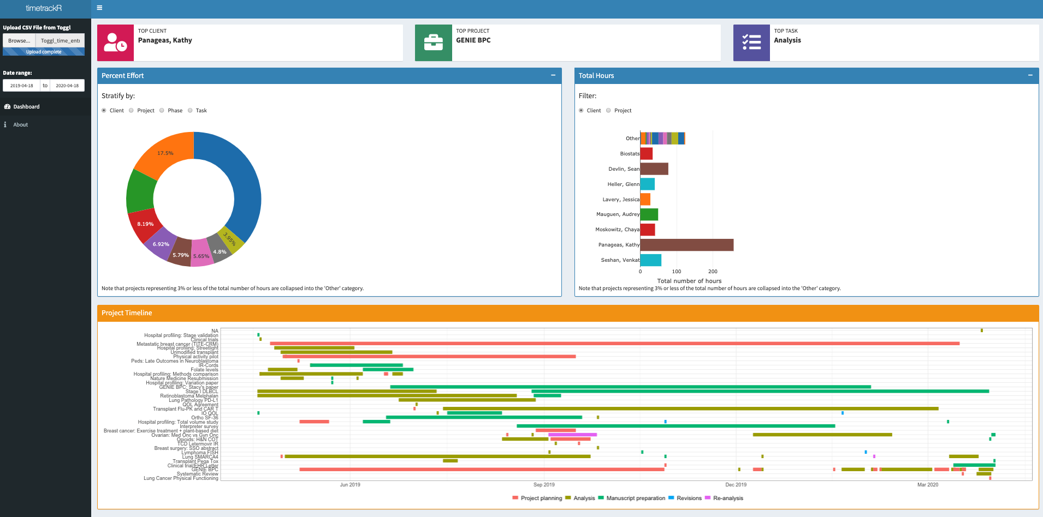
What is timetrackR?
A shinydashboard that takes recorded hours logged in toggl & creates useful data visualizations and summaries of how you’re spending your time

Slide 14
timetrackR: Motivation & Goals
Motivation
Interested in full customizability
Professional development: Wanted experience with R & Shiny
Used previous RLadies presentation to get started: Learning Shiny with NBA data
Goals
Wanted simple, easily interpretable metrics/visualization
Didn’t want to spend all of my time analyzing my time
Use for goal-setting and evaluating overall project flow
Aid in forecasting/resource allocation decisions
Improving efficiency: “Where is my time going and can it be efficiently (re-) directed?”

Slide 15
timetrackR Metrics & Visualizations
Percent effort: Time spent per project/investigator/project phase
Total hours: Cumulative number of hours spent on a project
Project Timeline: Visualization of project phase by calendar time
Notes:
Brief note that a lot of what I’m going to talk about has to do with the structure of my job, which is primarily project based across multiple investigators. While that specific scenario won’t hold for everyone here, the general concepts are applicable.

Slide 16
Time tracking metrics: Percent effort
Allocated vs expended effort
Did an investigator ask for “quick help” on a project that is now taking up 30 hours a week?
Task management
As a statistician, what percentage of time is spent in meetings vs doing analyses? Does this need to be rebalanced?
Are the right projects/tasks being prioritized?
Protecting your time
What percentage of my time am I spending on professional development? Is this more or less than I want it to be?
What percentage of my time am I spending on departmental activities (seminars, interviews, etc.) or other non-project work? Am I appropriately accounting for that when estimating how long it will take me to complete a project?

Slide 17
Time tracking metrics: Total hours
Comparing time invested to products generated
Did an abstract take as long as a full analysis for a manuscript?
For a time-intensive project, was the result multiple manuscripts?
Determining when to cut your losses and when to pursue a project further
“We’ve spent 200+ hours on this project and aren’t close to the deliverable. Is this even going to be feasible?”
“We’ve spent 100 hours on work for this conference presentation, should we turn it into a manuscript?”
Guiding project workflow & managing re-analysis
Useful metric for when re-analyses are requested
“We’ve spent 20 hours on the analysis, please circulate the manuscript draft before we complete additional analyses.”

Slide 18
Time tracking viz: Project Timeline
Useful for a big picture overview of what projects are going on & when (and for how long)
Based on a Gantt Chart which is usually used prospectively, but good for a year in review when used retrospectively
Indicates transitions between analysis and re-analysis, indicates if analyses are happening after a manuscript is drafted, etc.
Want to see: Project planning -> Analysis -> Manuscript -> Revisions
Do not want to see: Analysis -> Manuscript -> Re-analysis -> Project Planning -> Analysis -> etc.

Slide 19
timetrackR demo
Notes:
timetrackr.shinyapps.io/timetrackr

Slide 20
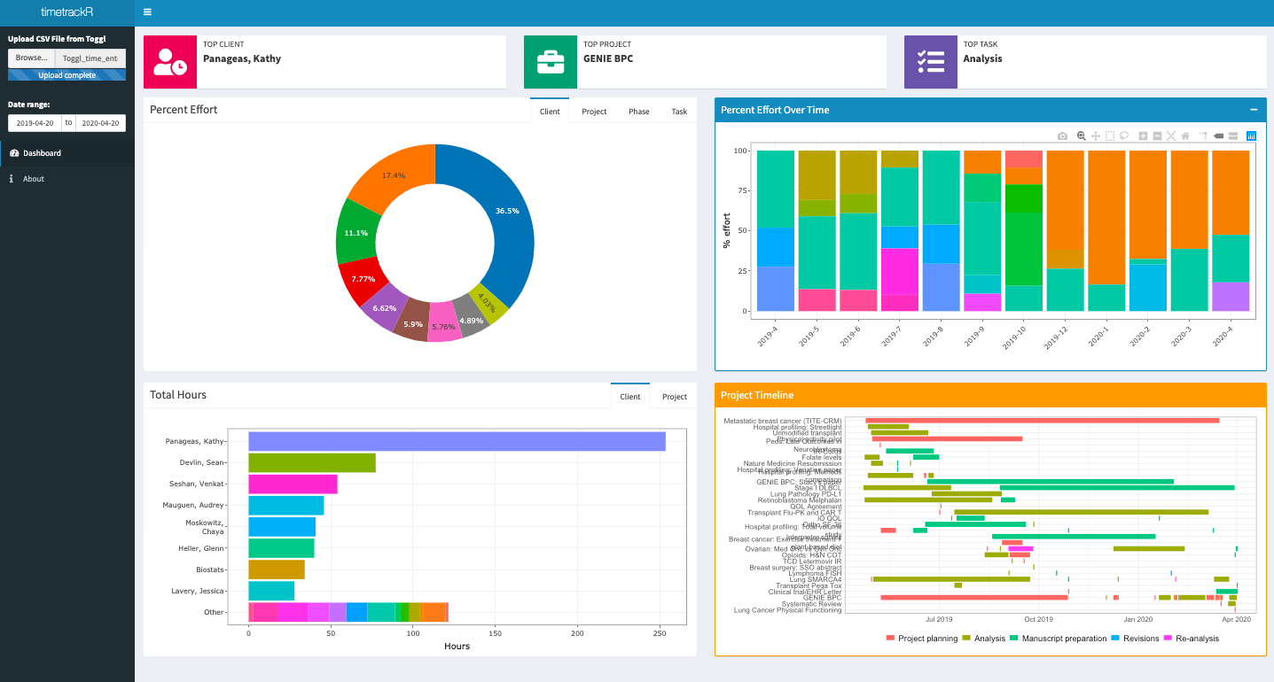

Slide 21
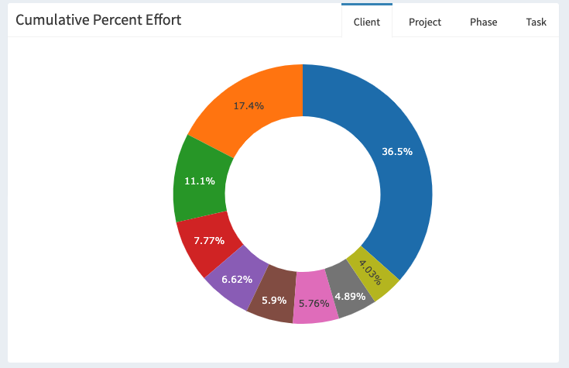

Slide 22
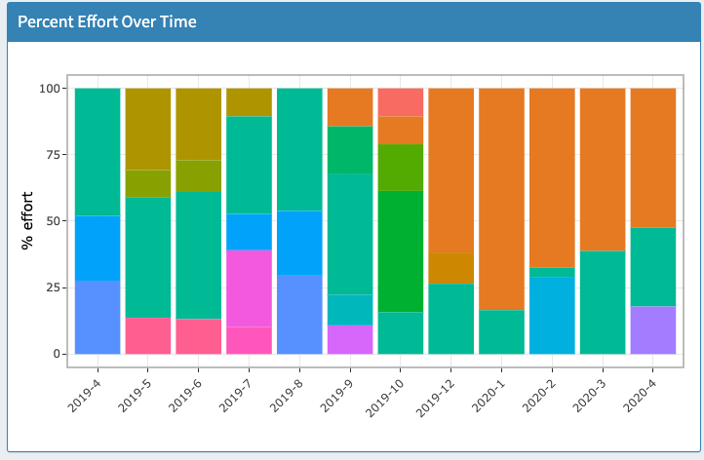

Slide 23
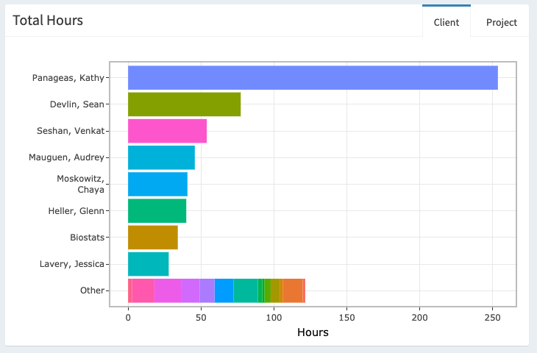

Slide 24
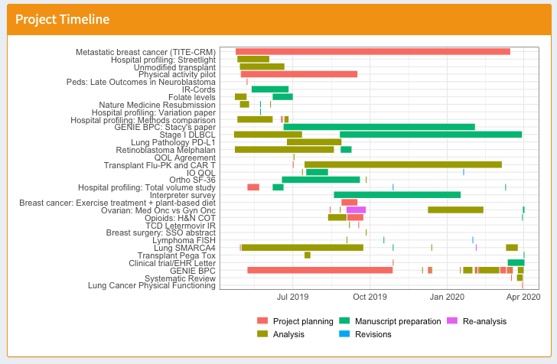

Slide 25
Information learned from timetrackR
In the last 3 months, >75% of my time has been devoted to a single project. Can we can bring someone else on to that project? (percent effort)
I spent more hours on a presentation for a conference than I thought I did. Maybe I should turn that into a manuscript? (total hours)
A particular project transitioned between analysis and re-analysis several times throughout the project’s life cycle. Is it time for a regroup with the investigator? (project timeline)

Slide 26
Workflow integration
Daily basis: Use Toggl to record how you’re spending your time
Requires minimal setup for project/clients
Spend <5 minutes a day recording my time
Weekly? Monthly? Quarterly?: Export data from Toggl into timetrackR to look at how you’ve been spending your time

Slide 27
R Code Highlights: - switch function - geom_segment() - hex sticker - Hosting a shiny app

Slide 28
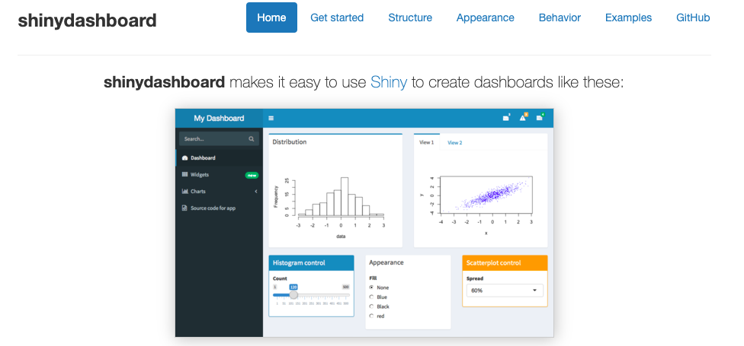
Behind the scenes
timetrackR originated as a traditional shiny app
Previously relied on manual time tracking via Excel spreadsheet
Its current form is a shinydashboard

Slide 29
The switch function
Used to update the figure depending on which input (statistician, date range, project status) is selected
To display the bar chart for active projects or for all projects:
Utilize radio button so that user can select active or all projects
Use the switch function to update the data frame depending on which is selected

Slide 30
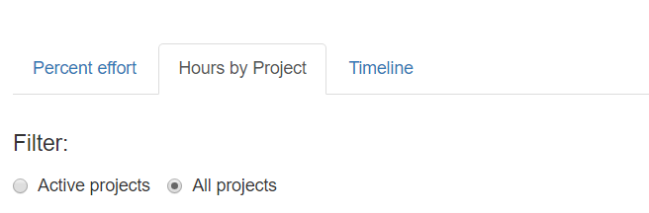
switch function: Bar chart application
App interface:
input$status_filter_bar returns either “Active projects” or “All projects” depending on which radio button is selected
Code (server.R):
Using switch function to subset the data on active projects if needed, otherwise proceeding with all projects
switch(input$status_filter_bar, "Active projects" = bar_filtered <- tracker %>% filter(status == "Active"), "All projects" = bar_filtered <- tracker)

Slide 31
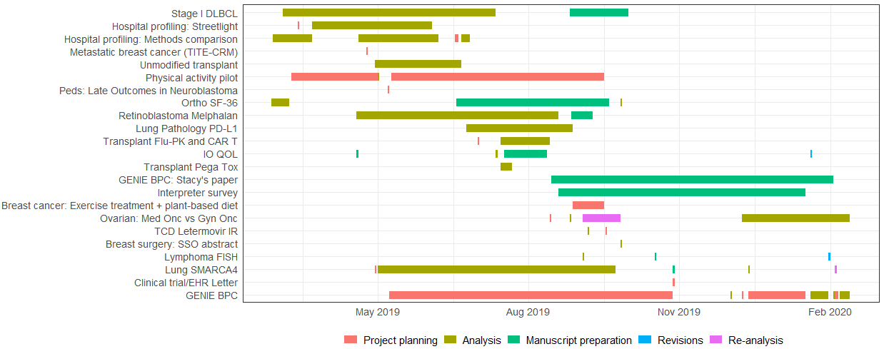
Project Timeline
Made using ggplot with geom_segment()

Slide 32
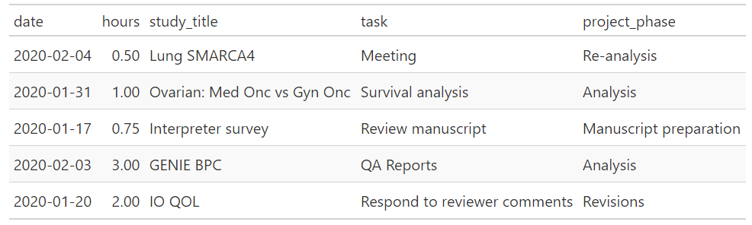
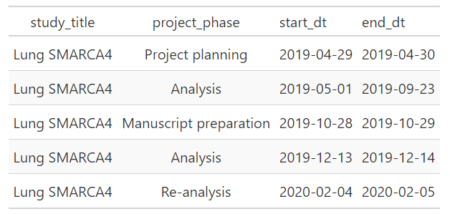
Project Timeline: Data wrangling
Summarize hourly data into project phase start / stop times

Slide 33
Project Timeline: Data Viz
ggplot(phase_filtered) + geom_segment(aes(x = start_dt, xend = end_dt, y = study_title, yend = study_title, colour = project_phase), size = 4) + theme_bw() + theme(legend.position = "bottom", legend.title = element_blank(), axis.title = element_blank(), axis.ticks = element_blank()) + scale_x_date(breaks = "3 months", date_labels = "%b %Y")

Slide 34
Unrelated to time tracking: Hex Sticker
library(hexSticker) sticker(# figure information subplot = "/calendar_light_orange.png", s_x = 1.05, s_y = .7,
s_width = 0.5, s_height = 0.6, # hex sticker information h_fill = "#007CBA", h_color = "#006098", # package information package = "timetrackR",
p_size = 8, p_color = "#F6C65B")
Notes:
https://github.com/GuangchuangYu/hexSticker

Slide 35
Hosting the shiny app
timetrackR is currently hosted on shinyapps.io
MSK has access to hosting shiny apps on Rconnect
Contact Juan Carlos for additional information about how to get set up

Slide 36
Caveats
Be careful about your denominators: Analysis is based on what you recorded
Entirely retrospective: it’s a summary of what you’ve done, doesn’t include projected time allocations

Slide 37
Future Plans
Incorporate additional visualizations and/or summary measures
Suggestions?
Integrate with Toggl’s API?
Integrate with additional time tracking software other than Toggl?

Slide 38
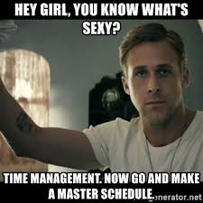
Summary
Very few metrics are needed to gain a general understanding of how you’re spending your time
This information can be used to align your work with how you intend to spend your time
Notes:
For discussion: Do others do this? If so, how? In conjunction with management or separately?

Slide 39

Thank you!
timetrackr.shinyapps.io/timetrackr
Special thanks to Margie Hannum & Karissa Whiting for sharing their creative naming skills to come up with the name of both the app and this talk.
Thanks also to Mike Curry for letting me use his time tracking data in earlier versions of the app and his patience in answering my many R questions.
https://github.com/jalavery/timetrackR

